Slide 1


ModelWriter Text & Model-Synchronized Document Engineering Platform
Project Leader: Ferhat Erata (ferhat@computer.org)
Project Email: project@modelwriter.eu

Slide 2
1 Introduction
Ferhat Erata
UNIT, ModelWriter Project Leader

Slide 3
Agenda [9:00 - 12:30]
Introduction (10 min) [09:00 - 09:10]
Overview of the project (20 min) [09:10 - 09:30]
Use-cases and exploitation prospects (45 min) [09:30 - 10:15]
Progress Status per WP (45 min) [10:15 - 11:00]
- Break (10 mins)
Demonstrations (30 min): [11:10 - 11:40]
Summary (achievements and exploitations) (5 min) [11:40 - 11:45]
Reviewers Private Section (30 min) [11:45 - 12:15]
Feedback Session (15min) [12:15 - 12:30]
Lunch (30 min) [12:30 - 13:00]

Slide 4







Participants ModelWriter #1 Review
Ferhat Erata
Dr. Moharram Challenger
Prof. Claire Gardent,
Prof. Samuel Cruz-Lara
Dr. Mariem Mahfoudh
Dr. Anne Monceaux
Dr. Eray Tuzun
Yvan Lussaud
Prof. Geylani Kardas
Hale Gezgen
Prof. Erhan Mengüsoğlu
Ersan Gürdoğan
Taskin Kızıl
Notes:
At this point chairman will give an introductory speech

Slide 5
2 Overview of the Project
Ferhat Erata
UNIT, ModelWriter Project Leader

Slide 6
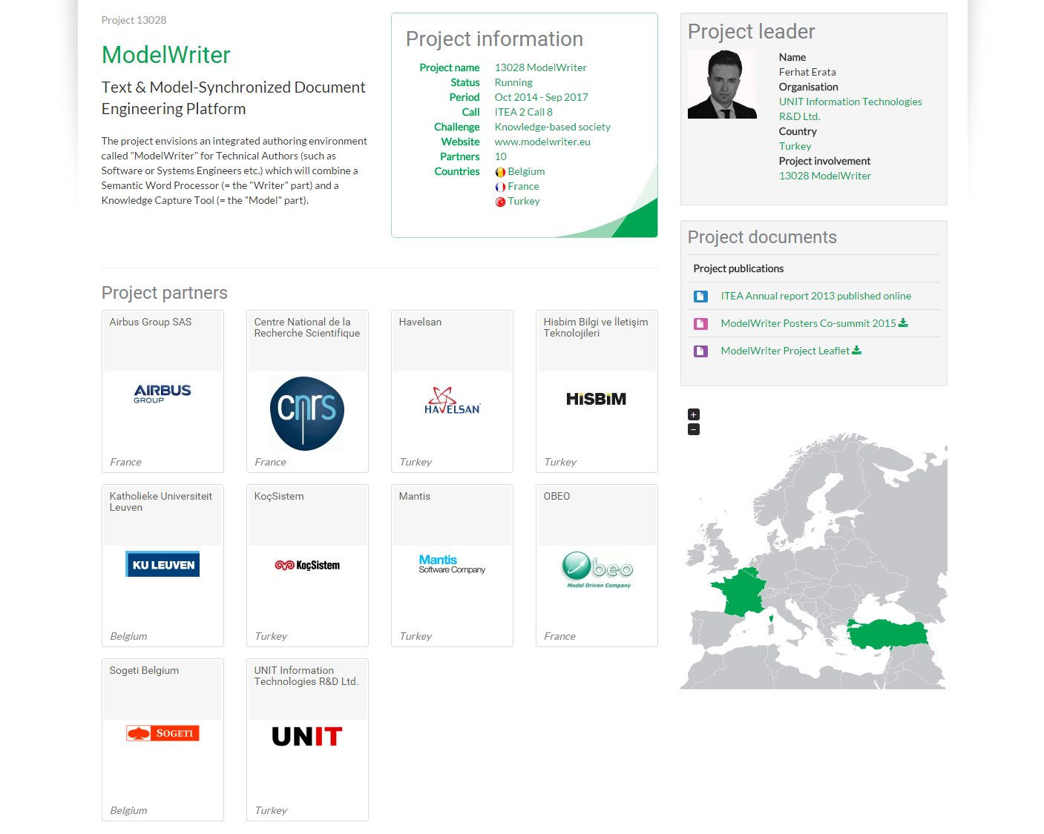
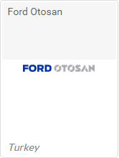
Industrial End User. Application Lifecycle Management (ALM)
Industrial End User.
Testing & Global Engineering Services
Industrial End User.
Product Lifecycle Management (PLM)

Slide 7
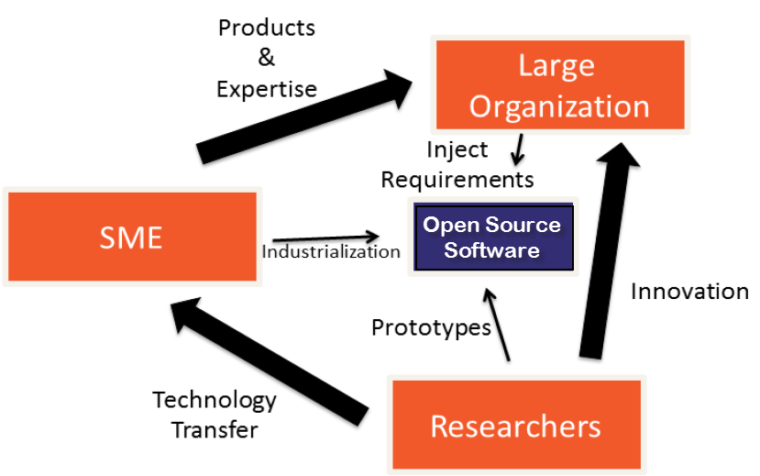



Industrialization Triangle in ModelWriter Open Source Software
Industrial Use Cases
Success Stories
Long Term Agreements
ModelWriter
New Product & Services
Commercialization
Open Source Software
Standardization
New Standard or Standard Extension
Publications, Open Source Software
Notes:
Open-Source Software Platform to be submitted to Eclipse Foundation
“MW” Knowledge Dissemination Standard (.mw ModelWriter exchange format)
We transfer the knowledge in university to industry which they develope theory and prototypes.
by means of combining the expertise of SMEs of the consortium (in our case, eclipse)
In this triangle, Large Organizations (most of their dominant core business is not developing software related services) provides the industrial expertise and define requirements
SMEs commercialize the solutions in the market as products.

Slide 8
ModelWriter Project Overview
Resource Allocation: 68,71 person year
Project Duration: 36 months
Planned Budget: 5,543,000 Euro
Start and Finish Date: 01 Oct 2014 – 30 Sep 2017
Open-Source Software Platform to be submitted to Eclipse Foundation

Slide 9
ModelWriter Today’s Knowledge Capture
Knowledge Capture with Word Processors
Document-centric,
Knowledge Capture with Modelling Tools
Model-centric, Structural and formal
Seamless Knowledge Capture with ModelWriter
ModelWriter as integrated product
Technical Documents
Natural Language
multiple information modelling and exploitation tools (= “Model” part),
and keeps both views seamlessly synchronized with each other.
Requirements, Specifications Architectural Design Documents..
Very Informal ones (mind maps, text tables, spreadsheets)
Formal ones (UML, SysML, EMF, BPMN …)
Text-based
a Word Processor (= “Writer” part)

Slide 10
ModelWriter bi-directional Knowledge Capture tool

Slide 11
ModelWriter Text-Based Knowledge Extraction
Understands the various textual parts of a document expressed in Natural Language
Reveals concepts and relationships between them (“Model”-part)
Semantic Word Processor
(Text-Based Knowledge Extractor)
Consistency & Completeness Checking

Slide 12
ModelWriter Further Knowledge Valorizations
“Everywhere” Document Regeneration: "tell once, show everywhere“: recycling knowledge from (1) the same document, or of (2) another related document
Open Source Software under Eclipse Foundation for Future Dissemination and Exploitation to further extend the Business Value Chain
Consistency Checking: the objective to provide a Consistency Checker that automates Quality Reviews of Requirements Engineering
“MW” Knowledge Dissemination Standard (.mw ModelWriter exchange format)
Notes:
OPEN API: plug-ins (e.g. for a future Natural Language Question Answering System plug-in, domain-specific checkers or generators, etc.)

Slide 13
ModelWriter Technological components & interactions
Notes:
ModelWriter teknolojik bileşenleri ve birbiri ile etkileşimleri
Her bir bileşenin gerçekleştirimi teknik bir iş paketi ile yönetiliyor.
Model part, Writer part,
Model Tooling, Writer Tooling,
Knowledge Base,

Slide 14

ModelWriter Conceptual Architecture
Editor
Documents
(doc, docx, odt,textile,etc)
Text
Connectors
Text
Semantic
Module
KB
Model
Models Connectors
Model Integration
Module
Model
Models
Notes:
Simplified version of actual architecture, there is a striking resemblance between planned and actual ones which means logical decomposition of project based on fucntions corresponds the real architecture.

Slide 15
ModelWriter Work Packages & Technical Innovations
WP1 Industrial Use Cases and Requirements (AIRBUS)
WP3 (UNIT)
WP4 (MANTIS)
WP6 (OBEO)
WP2 (LORIA)
Semantic Parser
Bi-directional synchronization mechanism between texts and models
A federated Knowledge Base and its API
A complete “ModelWriter” tool integrating of all these in a consistent way
Synchronization mechanism between texts/models & knowledge base
bi-directional transformation between text and formal knowledge representation
User Interfaces
Consistency checker plug-in for consistency
Configuration & Traceability Components
Document Generation
WP5 Project Management (UNIT)
WP7 Standardization, Dissemination and Exploitation (OBEO)

Slide 16
ModelWriter Overall Progress in the first year
WP5: Management Infrastructure
(D5.1.1)
[M1]
WP1: Consolidated User Requirements
(D1.5.1 & D1.5.2)
[M6]
WP:1 Software Requirements
(D1.6.1 & D1.6.2)
[M7]
WP6: Architecture Design
(D6.1.2)
[M9]
WP3: Synchronization, Configuration, Traceability
(D3.4.1, D3.5.1, D3.6.1)
[M10]
WP6: Major first release
(D6.7.1)
[M16]
WP6: Several Prototypes
(D6.1.1)
[M8]
WP2: Semantic Parser
(D2.1.1, D2.1.2, D2.3.1)
[M11]
WP6: User Interfaces & Model & Text Connectors
(D6.3.1, D6.4.2)
[M12]

Slide 17
ModelWriter Workshops in the First Year https://github.com/modelwriter/workshops
The 1st International ModelWriter Workshop in Izmir, Turkey (Jan 15-17, 2015) [M4]
The 2nd International ModelWriter Workshop in Brussels, Belgium (Apr 30, 2015) [M7]
The 3rd International ModelWriter Workshop in Toulouse, France (Jun 22-23, 2015) [M10]
The 4th International ModelWriter Workshop in Brussels, Belgium (Sep 23-24, 2015) [M12]
The 1st International Eureka Project Exhibition in Berlin, Germany (Mar 10-11, 2015) [M6]
The 5th International ModelWriter Workshop in Ludwigsburg, Germany (Nov 2-5, 2015) [M16]
Project Kick-off in Istanbul, Turkey (Nov 08, 2014) [M1]
Initial Architectural Design, Indutrial Use Cases, Technical WP discussions
Collaboration Infrastructure
Exploitation: Havelsan’s participation
Consolidated User Requirements & Review
Software Requirements Review & Architecture
Rehearsal & Review
Integration of software components
Notes:
1.
2.
3.
4.
5.

Slide 18
Level of Collaboration within ModelWriter International Collaboration
Yvan Lussard
Ferhat Erata
Open Source Software (Eclipse Public License)
Eclipse Mylyn Intent Project Lead
ITEA2 ModelWriter Project Lead
AIRBUS SIDP Documentation
Requirement Formalization
Lifecycle Traceability
Dr. Anne Monceaux
Jean Souyris
ITEA3-ASSUME Project
Oğuzhan Şereflişan
Prof. Geylani Kardaş
Dr. Emrah Kınav
Notes:
New system (Exploitation): Exploitation of ModelWriter in ITEA3-ASSUME

Slide 19

Level of Collaboration within ModelWriter International Collaboration
Prof. Hans Vangheluwe
Prof. Geylani Kardaş
Dr. Eray Tüzün
International Collaboration
McGill University & University of Antwerp
Modeling, Design & Simulation Lab.
Multi-Paradigm Modeling, Formalism Transformation,
Multi Agent Software Lab.
Ege University
Domain Specific Modeling Languages
Application Lifecycle Management, Model Driven Engineering

Slide 20
Open Source Campaign Open Call for Industrial User Stories
Shape the future ModelWriter
Early adaptation of the technology
Long Term Support

Slide 21
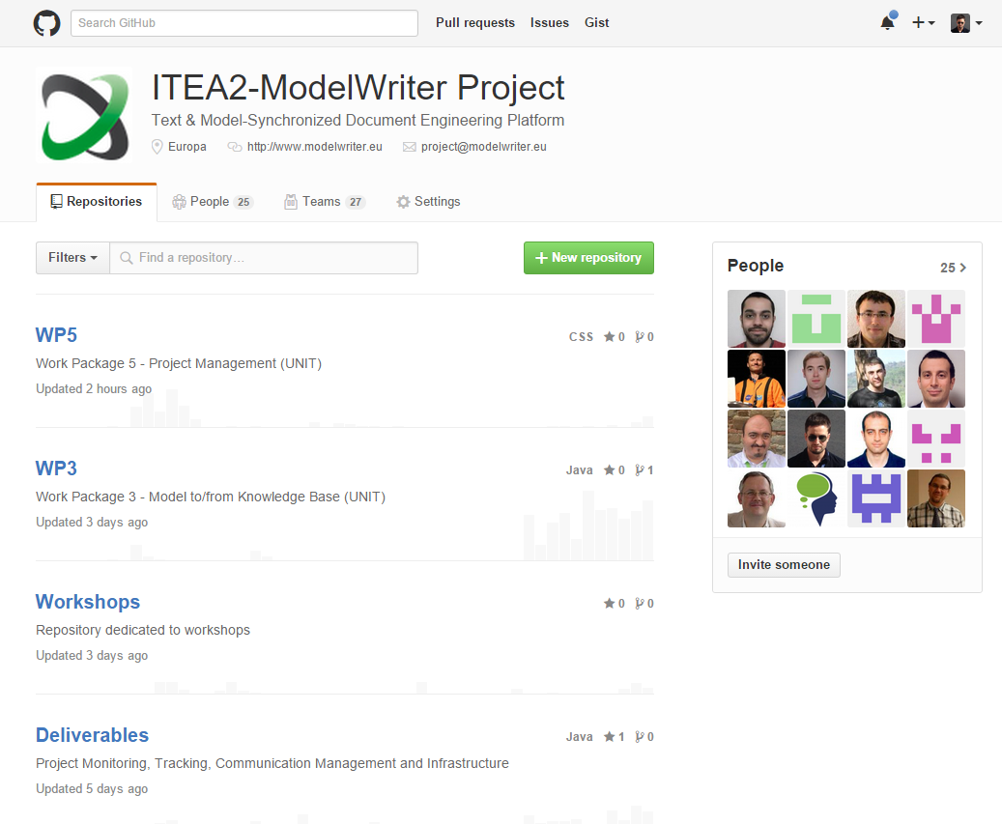
ModelWriter Open Source Campaign https://github.com/modelwriter
Notes:
GitHub donate us a lifetime license for our project

Slide 22
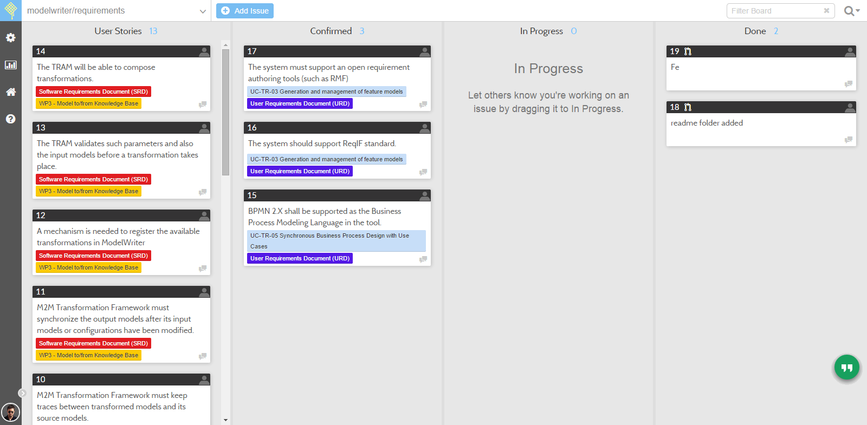
ModelWriter Requirements & User Stories https://waffle.io/modelwriter/requirements

Slide 23
ModelWriter Industrial Use Cases (Turkish Consortium)
IBM Rational Doors Plug-in and Eclipse Requirement Frameworks Sub-component which supports OMG’s ReqIF Standard.
UC-TR-03
Sync between Requirement Documentation and Feature Models
UC-TR-04
Integration with Application Lifecycle Management (ALM) Tools
UC-TR-05
Integration with Product Lifecycle Management (PLM), Technical Engineering Documents
KoçSistem, UNIT,
HAVELSAN, AIRBUS
Demonstrate that the ModelWriter concept can be usefully applied on ALM
UNIT, HAVELSAN
KoçSistem
UNIT, KoçSistem, Ford Otosan
Integration with Siemens Workspace

Slide 24
ModelWriter Industrial Use Cases (French Consortium)
Help determining the impacts of a change in the Enterprise Architecture
UC-FR-02
Enterprise Architecture
CEISAR - Center of Excellence in Enterprise Architecture
UC-FR-03
Synchronization of regulation documentation with a design rule repository
UC-FR-04
Production of a context specific design document
OBEO, TOTAL,
AIR France, AXA
This use case will explore the use of ModelWriter concept to structure and manage a repository of system installation rules.
OBEO, AIRBUS,
LORIA
Focus on building synchronized links between regulation documents in natural language and rules (as models).
OBEO, AIRBUS,
LORIA

Slide 25
Thank you for your attention We value your opinion and questions.

Slide 26
Thank you for your attention We value your opinion and questions.

Slide 27
Thank you for your attention We value your opinion and questions.

Slide 28
5 The Project Idea with Demonstrations
Ferhat Erata (UNIT, ModelWriter Project Leader)
Dr. Mariem Mahfoudh (CNRS/LORIA)

Slide 29
What is the problem?

Slide 30
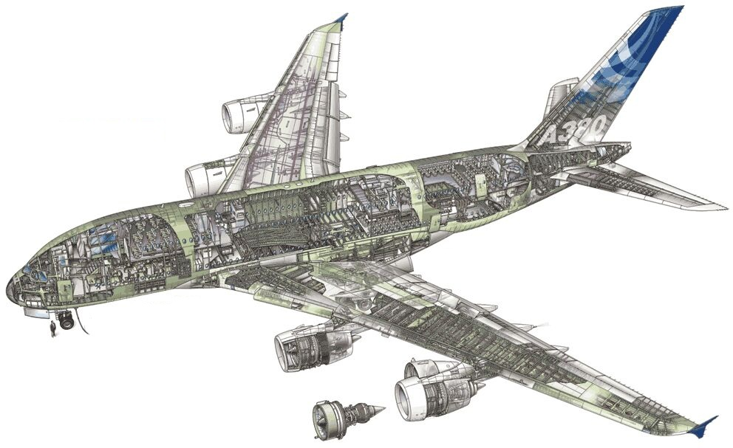
Airbus A380!
Imagine the documentation related to design principles.

Slide 31
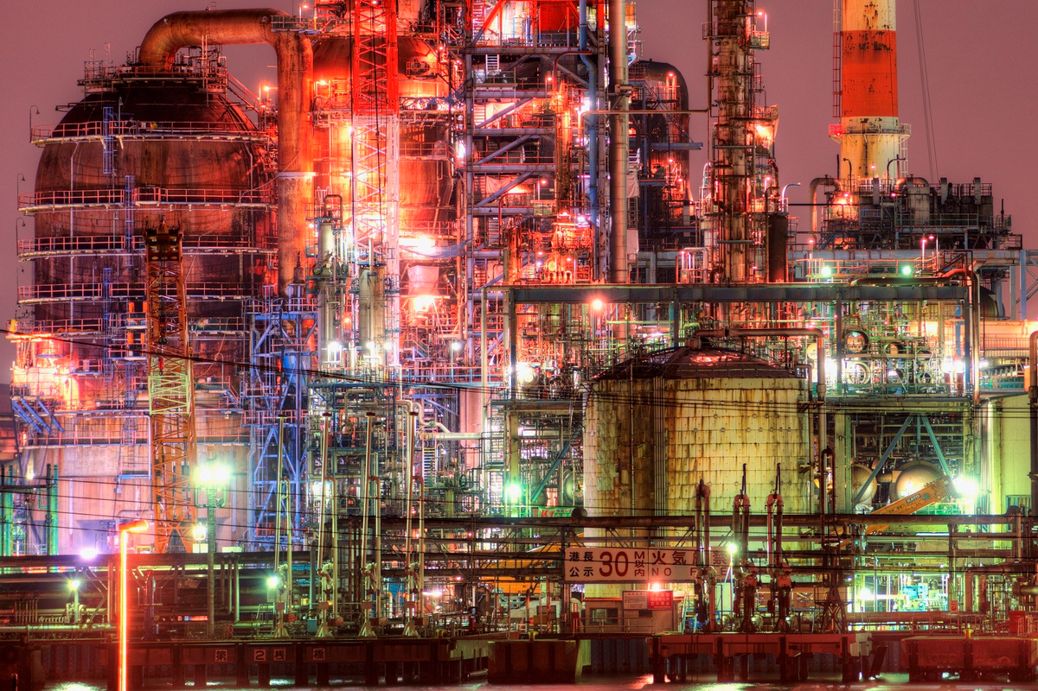
Plants!
Imagine the documentation of a construction site.

Slide 32
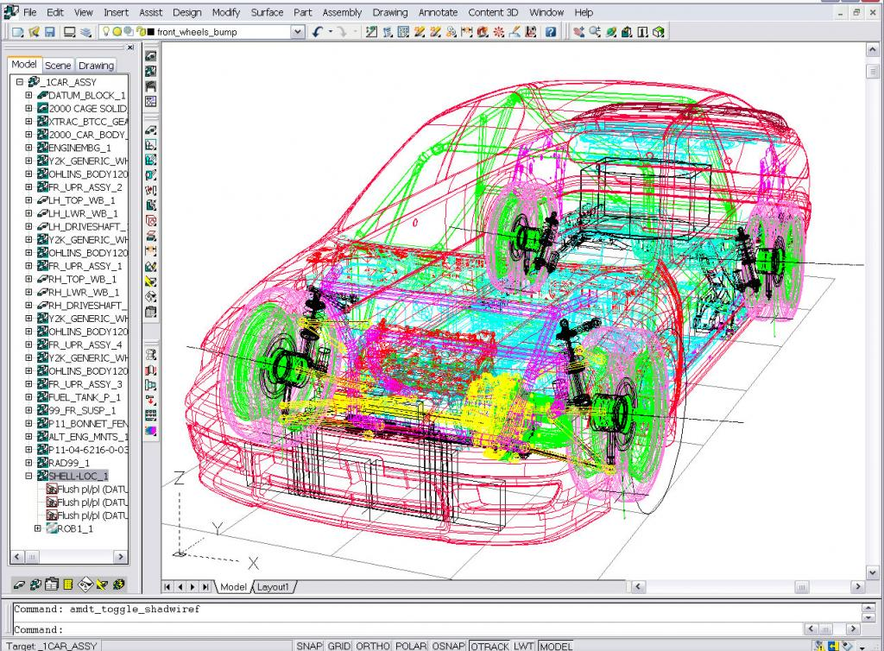
Automobiles!
Imagine the technical specifications

Slide 33
Documentation!
Write once … and never look at after

Slide 34
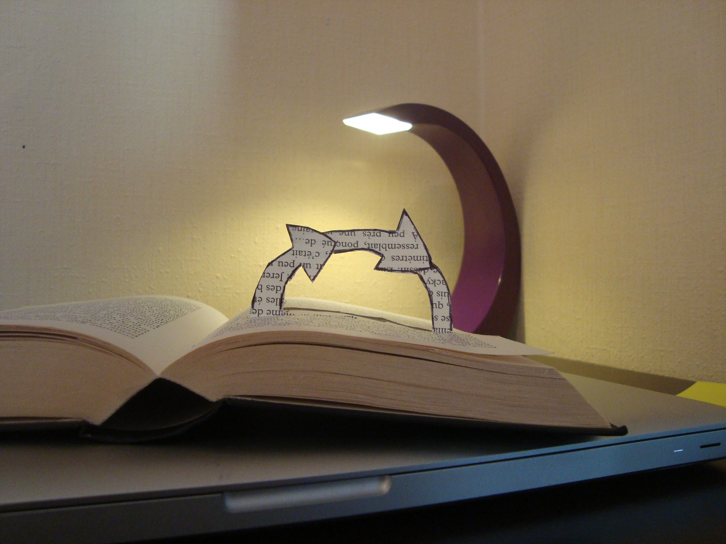
Documentation!
Hard to keep it up-to-date

Slide 35

Documentation!
Useful for users / Boring to write

Slide 36
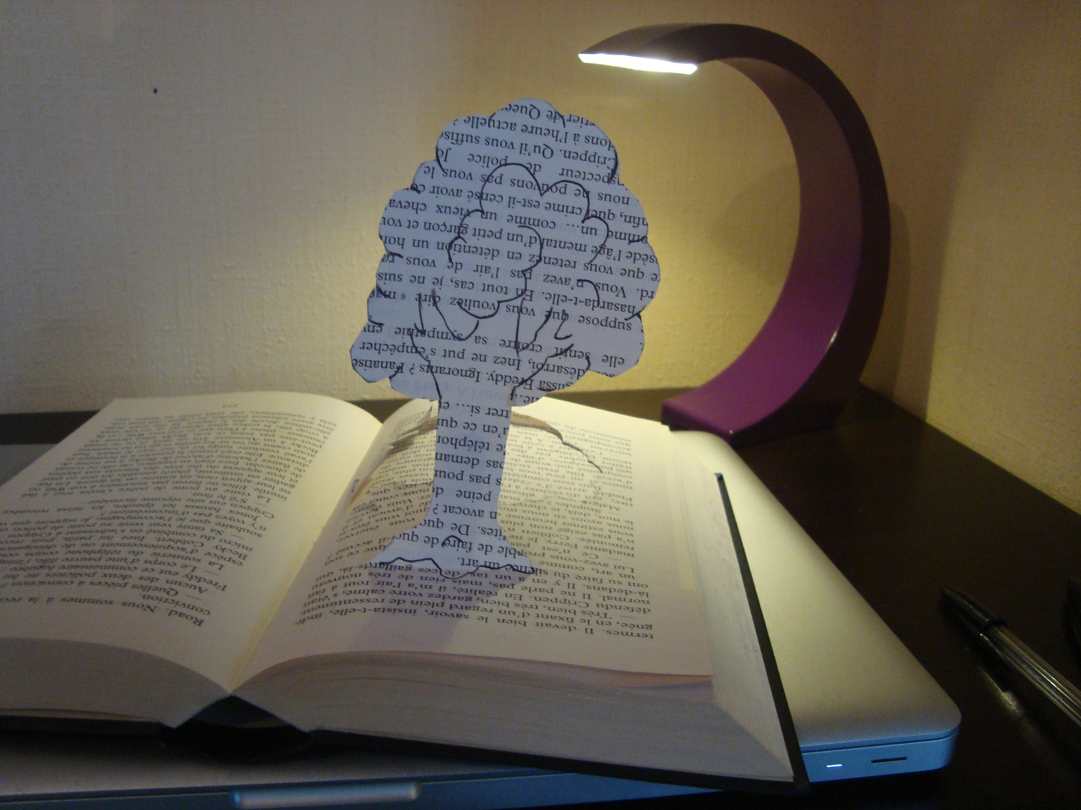
Semantics!
No meaning of syntax (words, sentences …)

Slide 37
What is a text?

Slide 38
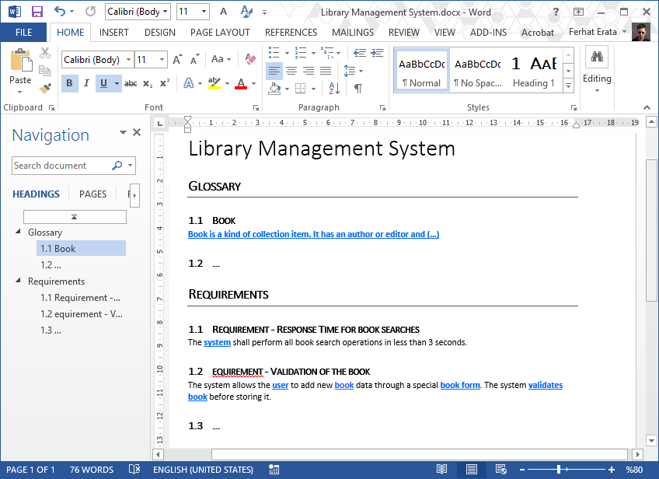
What is a text? (document file formats) Office Open XML (.docx) (ISO/IEC 29500)

Slide 39
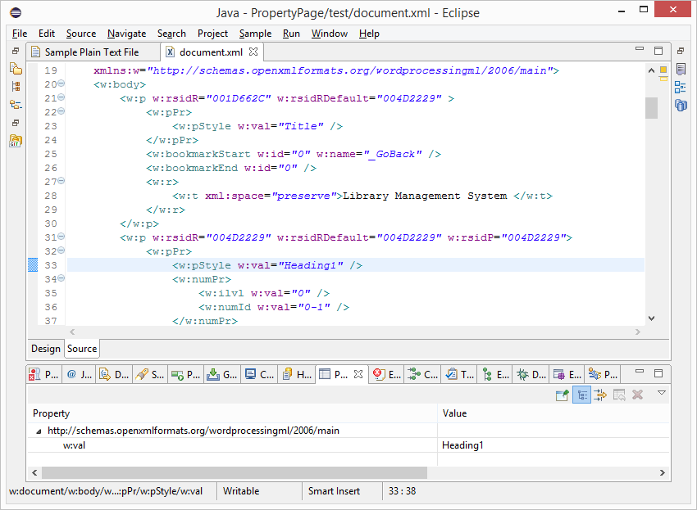
What is a text? (document file formats) Office Open XML (.docx) (ISO/IEC 29500)

Slide 40
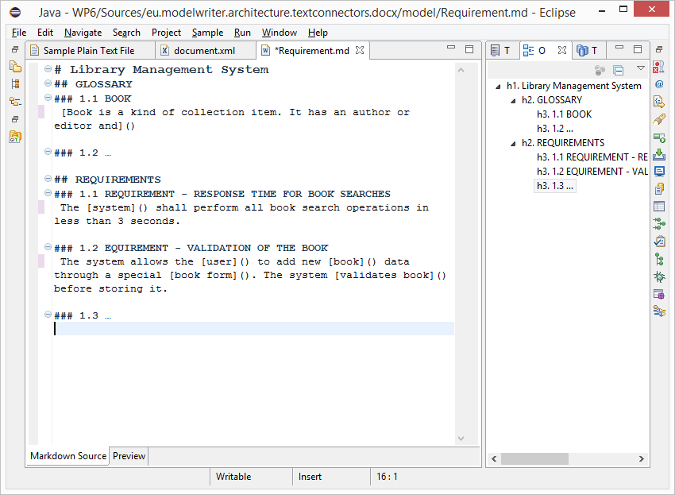
What is a text? (.md source file) text/markdown (ICANN Standard)

Slide 41
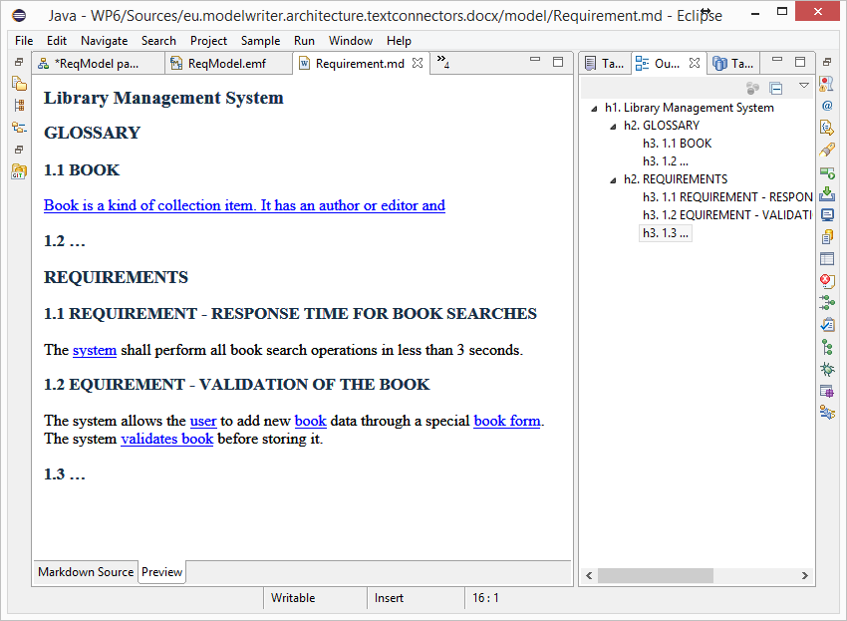
What is a text? (HTML Preview) text/markdown (ICANN Standard)

Slide 42
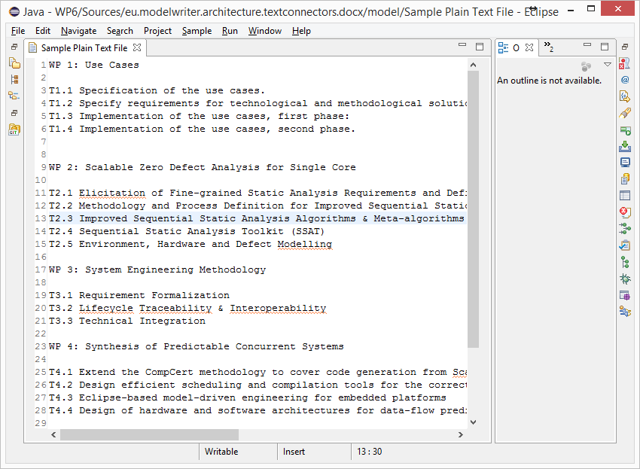
What is a text? (unformatted text) text/plain (ICANN Standard)

Slide 43
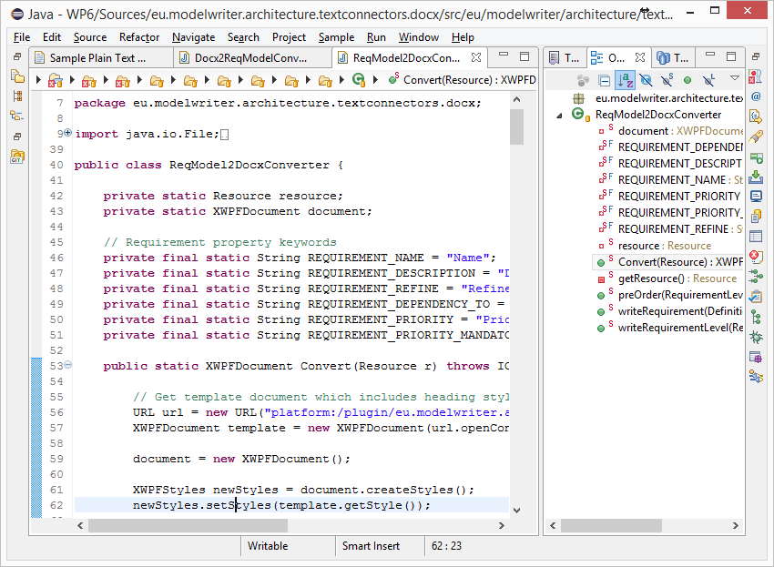
What is a text? (code files) Java, C++ … Programing Languages

Slide 44
What is a model?

Slide 45
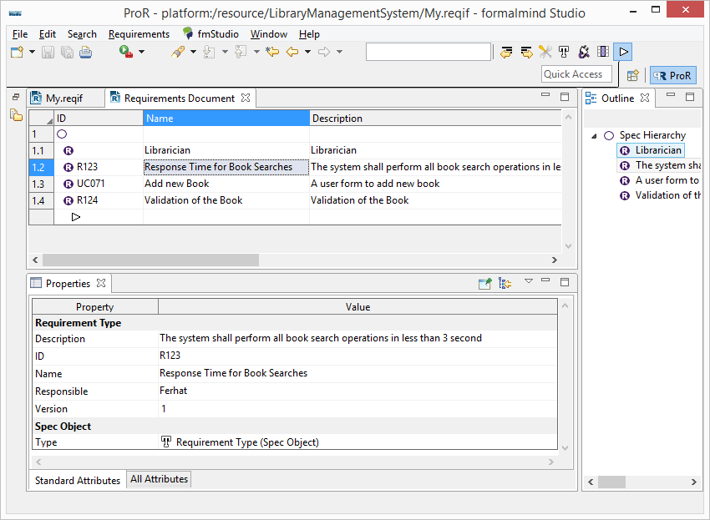
Everything is a model! (ReqIF Standard) Requirements Interchange Format

Slide 46
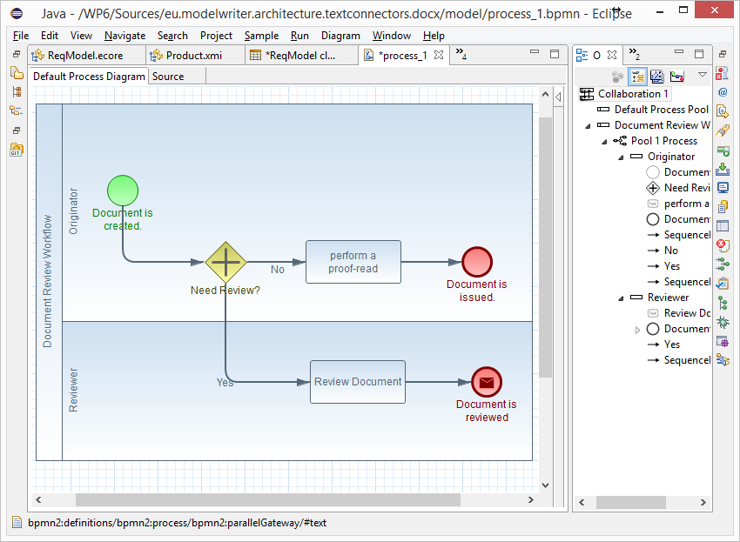
Everything is a model! (BPMN Standard) Business Process Model & Notation

Slide 47
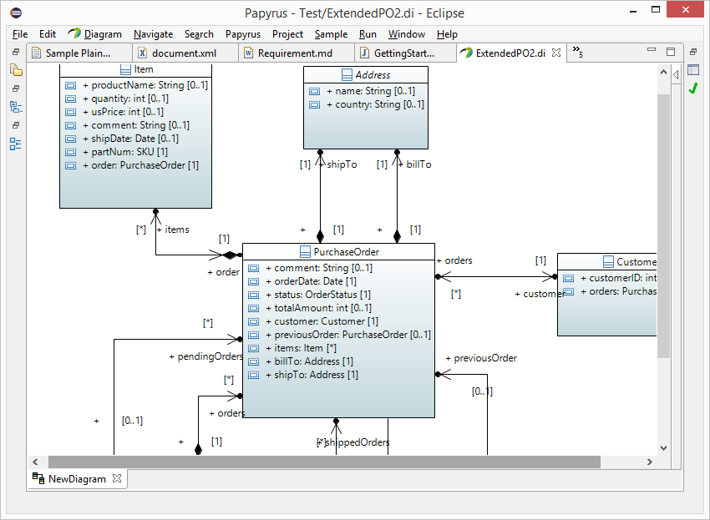
Everything is a model! (UML Standard) UML Modeling Languages

Slide 48
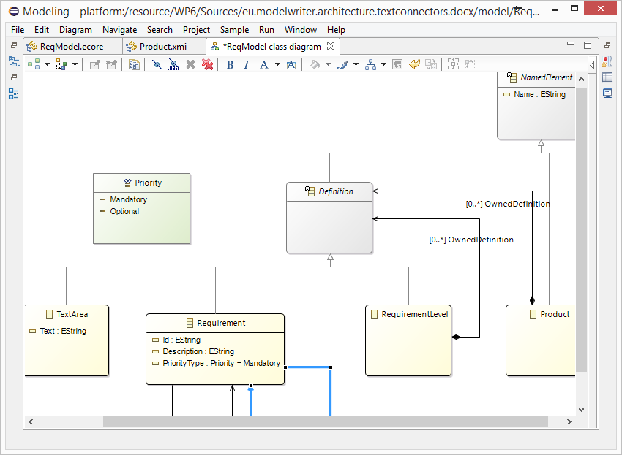
Everything is a model! Eclipse Modeling Framework (EMF)

Slide 49
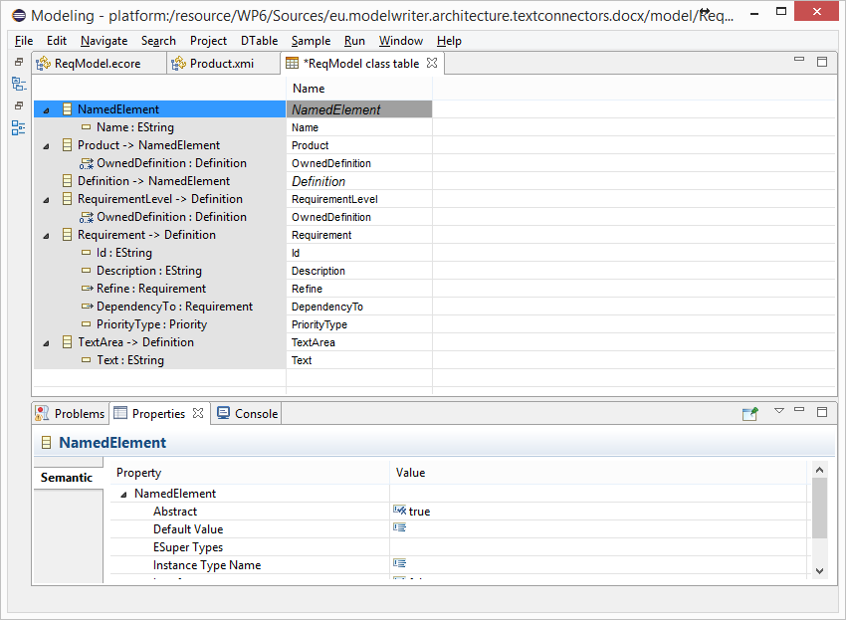
Everything is a model! Tree-based or Tabular Representations

Slide 50
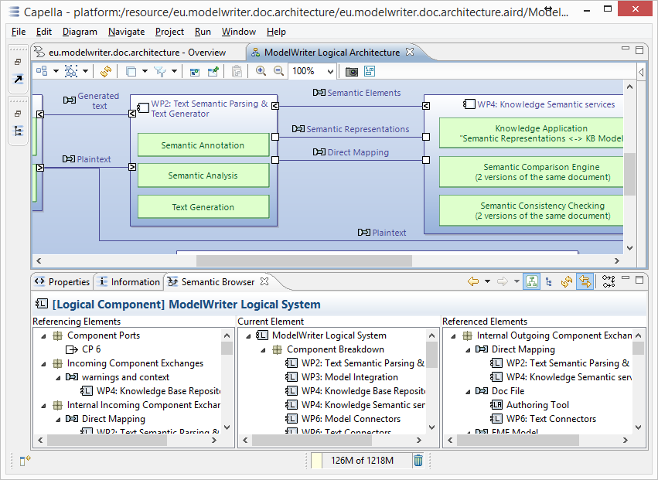
Everything is a model! Software/System Architecture Design

Slide 51
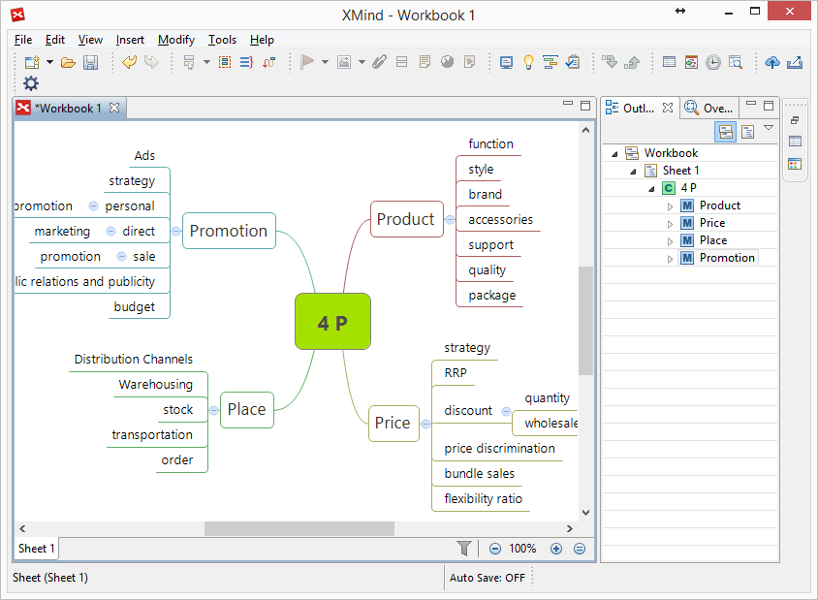
Everything is a model! Topic Maps, Mind Maps, Vocabularies …

Slide 52
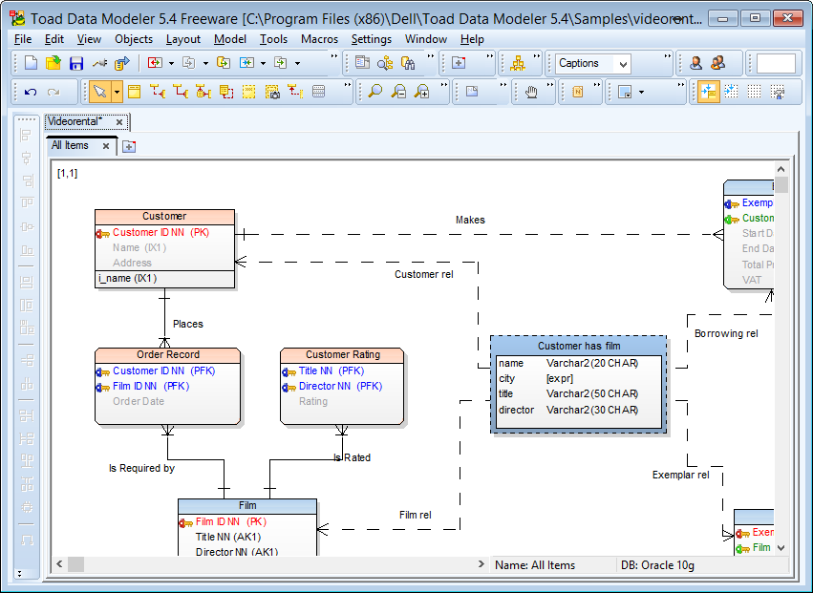
Everything is a model! Databases (ER, IDEF1.x)

Slide 53
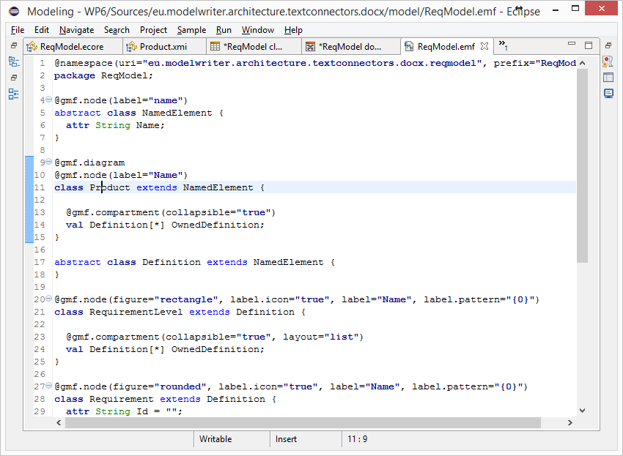
Everything is a model! (Textual Lang.) Domain Specific Languages

Slide 54
Everything is a model! (Java, C++, etc.) Even Programing Languages (ASTs)

Slide 55
Is it possible to connect and keep arbitrary software/system engineering artifacts synchronized ?

Slide 56
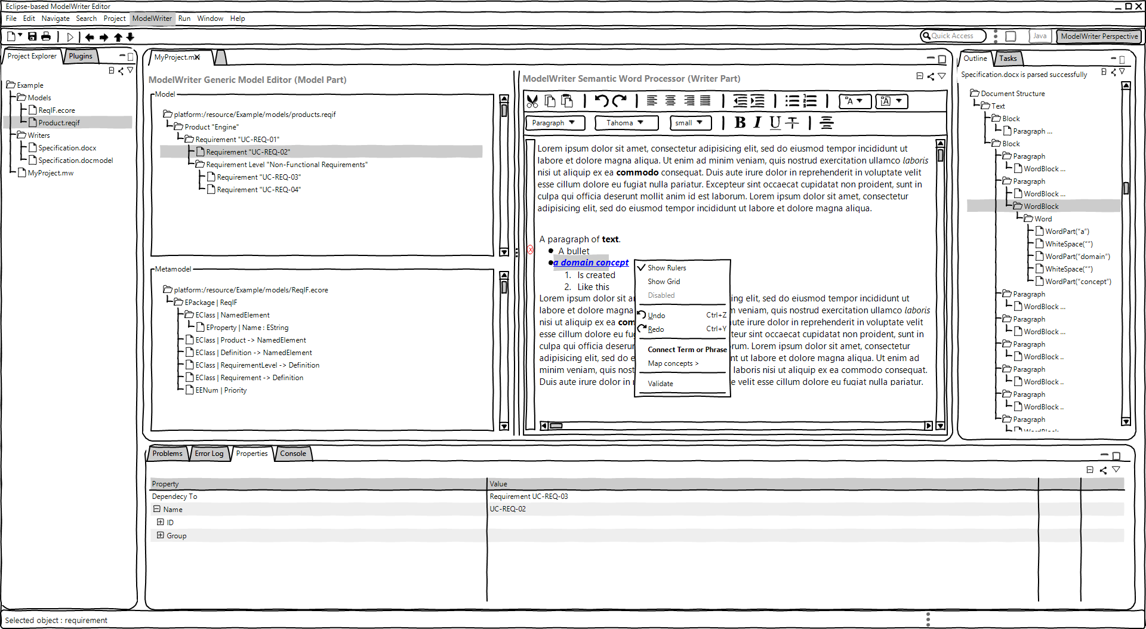
ModelWriter – The Solution
Text & Model-Synchronized Document Engineering Platform

Slide 57
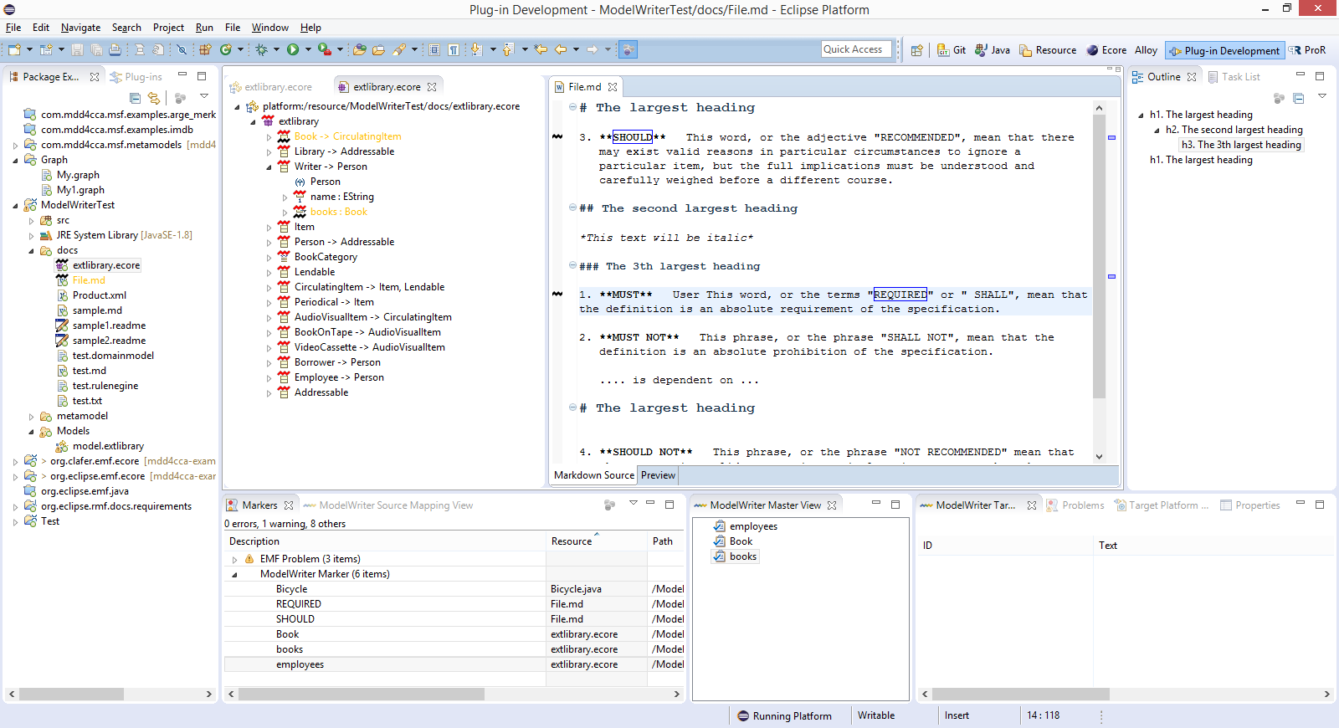
Solution – Knowledge Capture
Text & Model-Synchronized Document Engineering Platform

Slide 58
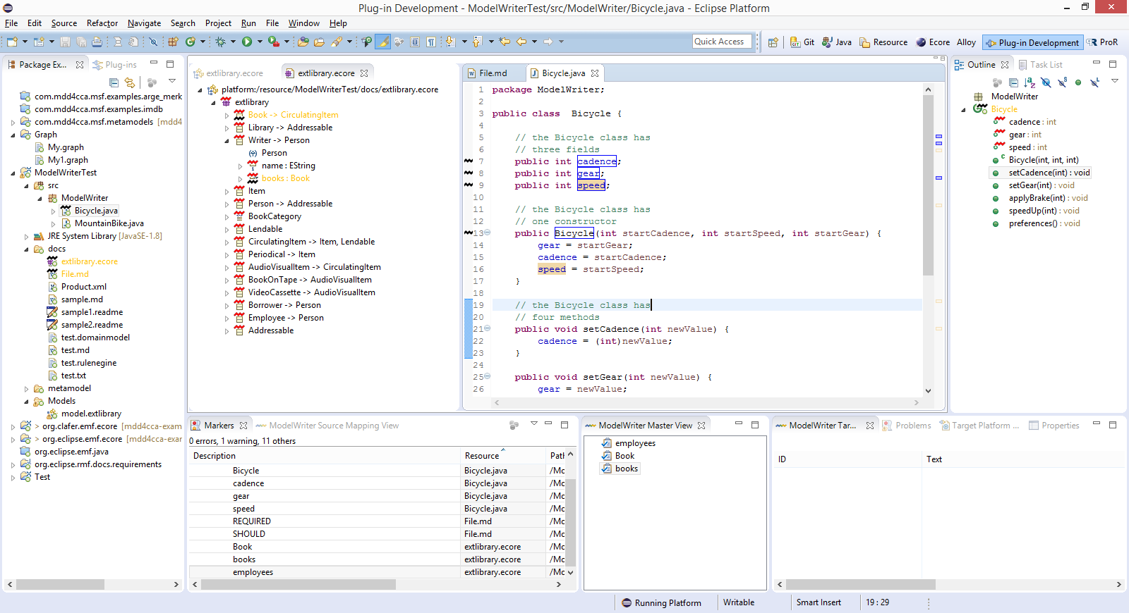
Solution – Knowledge Capture
Text & Model-Synchronized Document Engineering Platform

Slide 59
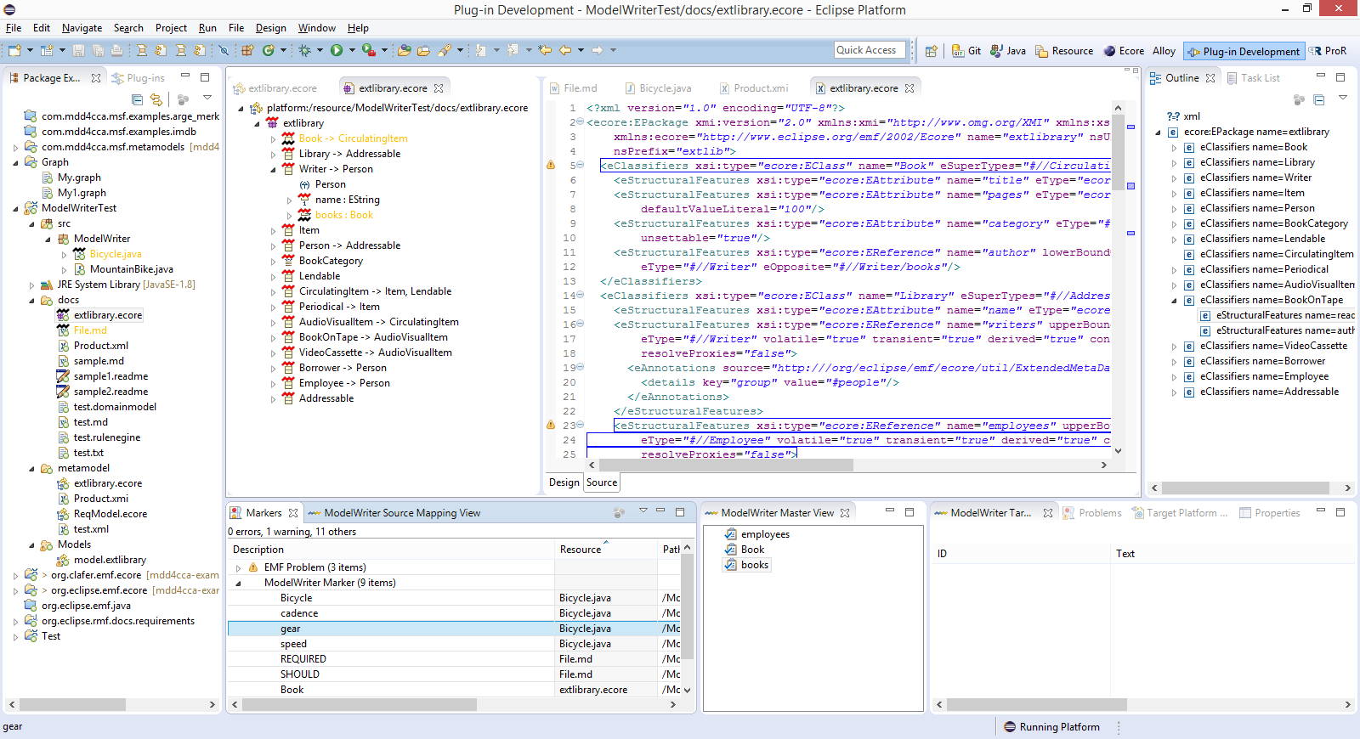
Solution – Knowledge Capture
Text & Model-Synchronized Document Engineering Platform

Slide 60
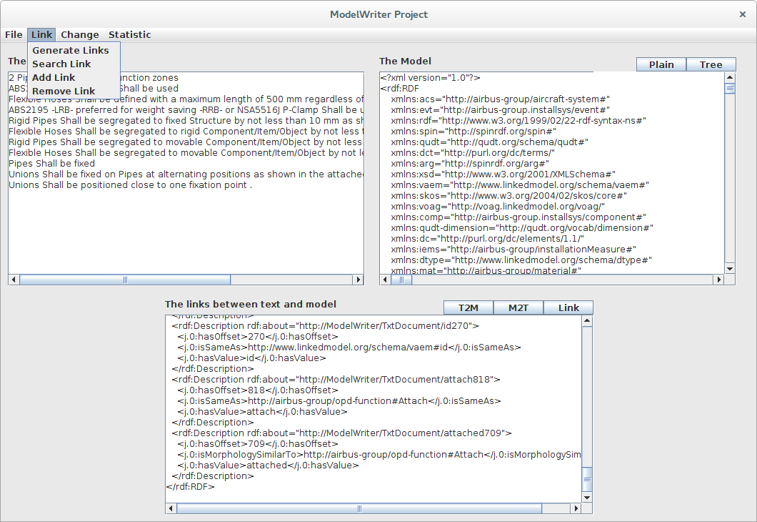
Solution – Knowledge Extraction
Text & Model-Synchronized Document Engineering Platform

Slide 61
Synchronization is maintained!

Slide 62
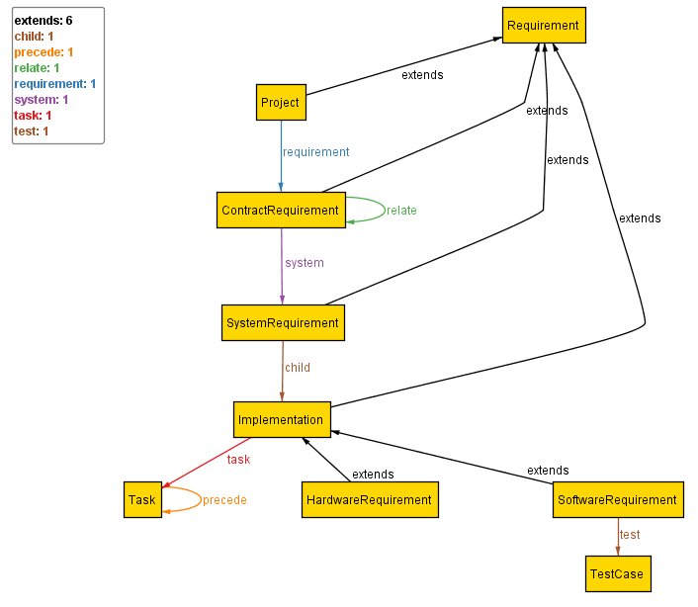
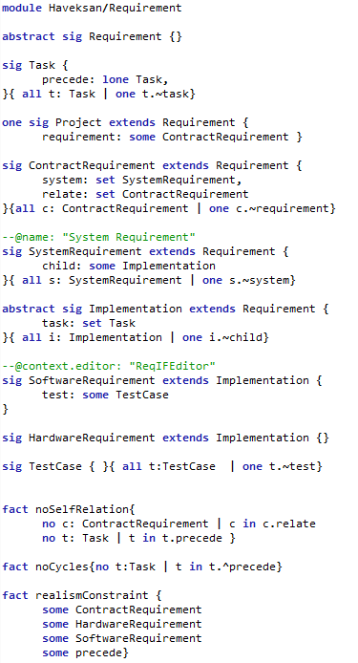
Configuration:HAVELSAN example
A Formal Specification Model to configure the ModelWriter

Slide 63
ModelWriter Quantification of the expected benefits
Improvement in quality and productivity of technical documentation.
Quality increase of the product with consistent requirements and designs.
For instance, according to AIRBUS’s claims in their use cases, the global saving would be 5 M€ to 7 M€ (A350 Recurring Cost)
50% reduction of costs for keeping the documentation up-to-date with the developed software

Slide 64
6 Summary of the Current Status The achievements and ERAs
Ferhat Erata
UNIT, ModelWriter Project Leader

Slide 65
ModelWriter Overall Progress in the first year
WP5: Management Infrastructure
(D5.1.1)
[M1]
WP1: Consolidated User Requirements
(D1.5.1 & D1.5.2)
[M6]
WP:1 Software Requirements
(D1.6.1 & D1.6.2)
[M7]
WP6: Architecture Design
(D6.1.2)
[M9]
WP3: Synchronization, Configuration, Traceability
(D3.4.1, D3.5.1, D3.6.1)
[M10]
WP6: Major first release
(D6.7.1)
[M16]
WP6: Several Prototypes
(D6.1.1)
[M8]
WP2: Semantic Parser
(D2.2.1, D2.1.2, D2.5.1)
[M11]
WP6: User Interfaces & Model & Text Connectors
(D6.3.1, D6.4.2)
[M12]

Slide 66
Achivements - Exploitation

Slide 67
Achivements - Standardization

Slide 68
Thank you for your attention We value your opinion and questions.

